Slide 1
Zonghua Gu
General Purpose Input/Output (GPIO)
Fall 2025
Acknowledgement: some slides taken from instructor resources of Daniel Lewis textbook

Slide 2
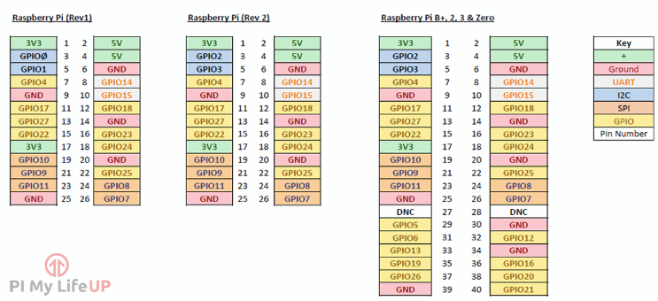
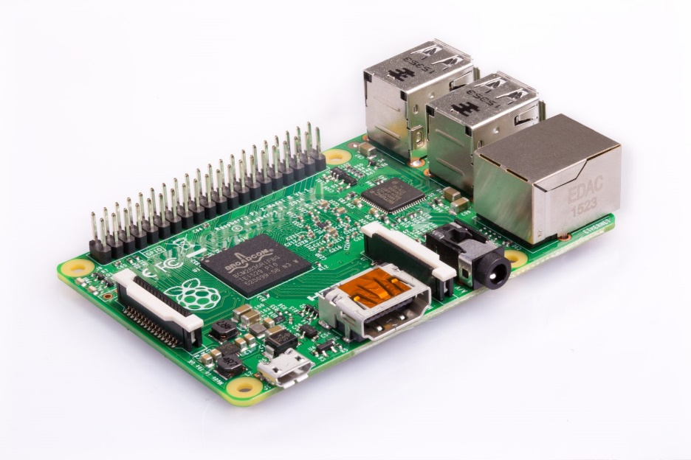

Raspberry Pi GPIO pins

Slide 3
Interfacing Peripherals
Port-mapped I/O
Use special CPU instructions: Special_instruction Reg, Port
Memory-mapped I/O
A simpler and more convenient way to interface I/O devices
Each device registers is assigned to a memory address in the address space of the microprocessor
Use native CPU load/store instructions: LDR/STR Reg, [Reg, #imm]
0x48000024
0x48000020
0x4800001C
0x48000018
0x48000014 | GPIO Data Output Register
0x48000010
Core
STR
Pin output
GPIO Output
Memory Space
ARM Cortex-M microprocessors use memory-mapped I/O.
Notes:
Usually, each on-chip peripheral device has a few registers, such as control registers, status registers, data input registers, and data output registers. In general, there are two approaches to exchange data between the processor core, and a peripheral device, including {{Pause=0.5}} port-mapped I/O, and {{Pause=0.5}} memory-mapped I/O. Port-mapped I/O uses special CPU instructions, which are designed specifically for I/O operations. {{Pause=0.5}} On the other hand, memory-mapped I/O does not need any special instructions. Each register is assigned to a memory address, in the memory address space of the microprocessor. Memory-mapped I/O is performed by the native load and store instructions of the processor. Therefore, memory-mapped I/O is a more convenient way to interface I/O devices.
Here is an example of memory mapped I/O. Suppose we want to set the output of a G P I O pin to high, software can use the store instruction STR to set the corresponding bit in G P I O data output register to 1. When you write to this “special memory location”, the data you write, is sent to, the corresponding I/O device. {{Pause=0.5}} ARM Cortex-M microprocessors use memory-mapped I/O.

Slide 4
Memory Map of Cortex-M4 (Pi uses Cortex-A53)
0xFFFFFFFF
NVIC, System Timer, SCB, vendor-specific memory
System
0.5 GB
0xE0000000
External Device
1 GB
Such as SD card
0xA0000000
External RAM
1 GB
4 GB
Off-chip memory for data
0x60000000
Peripheral
0.5 GB
AHB & APB, such as timers, GPIO
0x40000000
SRAM
On-chip RAM, for heap, stack, & code
0.5 GB
0x20000000
0.5 GB
Code
On-chip Flash, for code & data
0x00000000
One Byte (8 bits)
Notes:
The memory address of ARM Cortex-M has a total of 32 bits, supporting 4 gigabytes of memory space. The memory space is divided into six different pre-defined regions. Each region is given for recommended usage. {{Pause=0.5}} The first region is code region. It is primarily used to store program code. It can also store data. The code region is on-chip memory, typically on-chip flash. The size of on-chip flash is limited to half a gigabyte. The actual size of the on-chip flash varies based on different venders and different chips. {{Pause=0.5}} The second region is SRAM. It is primarily used to store data, such as heaps and stacks. We can also put code here. It supports half a gigabyte. {{Pause=0.5}} The third region is peripheral. These peripherals include Advanced High Performance Bus peripherals, such as G P I O, and A D C, or Advanced Peripheral Bus peripherals, such as timers, and USART. {{Pause=0.5}} The next region is for external device, such as SD card. {{Pause=0.5}} The next is external RAM, which is executable region for data. It is off-chip memory, primarily used to store large data blocks. It has a total of 1 gigabyte. {{Pause=0.5}} The last region is system region, which includes the N V I C, system timer, system control block, and vendor-specific memory.

Slide 5
Memory Map of STM32L4
0xFFFFFFFF
System
0.5 GB
0xE0000000
External Device
1 GB
0xA0000000
0x60000000
External RAM
…
1 GB
0x48001000
GPIO D (1 KB)
0x60000000
Peripheral
0x48000C00
0.5 GB
GPIO C (1 KB)
0x40000000
0x48000800
SRAM
GPIO B (1 KB)
0.5 GB
0x48000400
0x20000000
GPIO A (1 KB)
0.5 GB
Code
0x48000000
…
0x00000000
0x40000000
One Byte (8 bits)
Notes:
{{Pause=0.5}} Let’s take a look at the peripheral region. This region covers the memory addresses of all on-chip peripherals, such as G P I O, timers, USART, S P I, and A D C. {{Pause=0.5}} Specific mapping addresses are dependent on vendors and chips. We will use G P I O on STM 32 L4 as an example to illustrate the concept of memory-mapped I/O. For instance, on STM 32 L4, the registers of G P I O Port A, are mapped to a small memory region starting at, 48000000 in hex.

Slide 6
Steps to using GPIO pins
1) Configure the pin as an input or an output
A) Get the address of the appropriate GPSEL0 register
B) ORR the current value with the value you want
1) Set or clear the pin
A) Get the address of GPSET or GPCLR register
B) ORR the current value with the value you want

Slide 7
Memory-mapped GPIO Cortex-A53 (Pi)
GPCLR1
GPCLR0
///////////////////////
GPSET1
GPSET0
///////////////////////
GPSEL5
GPSEL4
GPSEL3
GPSEL2
GPSEL1
GPSEL0
P31 | P30 | P29 | P28 | P27
P31 | P30 | P29 | P28 | P27
…
P43 | P42 | P41 | P40 | P39 | P38 | P37 | P36 | P35 | P34 | P33 | P32
P11 | P10 | P9 | P8 | P7 | P6 | P5 | P4 | P3 | P2 | P1 | P0
P43 | P42 | P41 | P40 | P39 | P38 | P37 | P36 | P35 | P34 | P33 | P32
P11 | P10 | P9 | P8 | P7 | P6 | P5 | P4 | P3 | P2 | P1 | P0
N/A
N/A
GPIO_BASE + 40
…
GPIO_BASE + 28
N/A
N/A
…
N/A
N/A
Pin 53 | Pin 52 | Pin 51 | Pin 50
N/A
Pin 49
Pin 43 | Pin 42 | Pin 41 | Pin 40
N/A
Pin 39
…
Pin 33 | Pin 32 | Pin 31 | Pin 30
N/A
Pin 29
Pin 23 | Pin 22 | Pin 21 | Pin 20
GPIO_BASE
N/A
Pin 19
…
Pin 13 | Pin 12 | Pin 11 | Pin 10
< --------------32 bits ------------->
N/A
Pin 9
Pin 3 | Pin 2 | Pin 1 | Pin 0

Slide 8
Thinking about memory addresses
GPSEL0 + 4
Pins 12-15
Pins 8-11
Pins 4-7
Pins 0-3
GPSEL0 + 3
GPSEL0
GPSEL0 + 2
GPSEL0 + 1
GPSEL0 (GPIO_BASE)

Slide 9
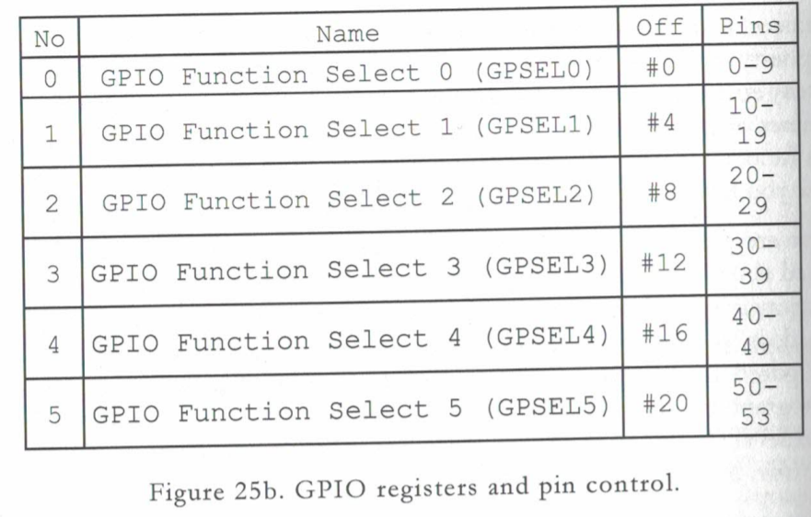
GPSEL Registers on ARM-Cortex A53 (Pi)

Slide 10
GPSEL0 Register
Pin 9 | Pin 8 | Pin 7 | Pin 6 | Pin 5 | Pin 4 | Pin 3 | Pin 2 | Pin 1 | Pin 0
How would we set pin 2 as an output in assembly?
LDR R1, =GPSEL0
LDR R2, [R1]
MOV R3, #1<<6
ORR R2, R3
STR R2, [R1]

Slide 11
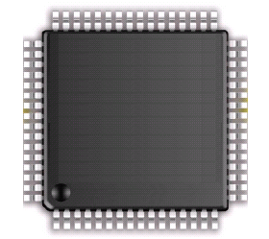
General Purpose Input/Output (GPIO)
D Bus
FLASH
ARM Cortex-M4
FPU
I Bus
AHB Bus Matrix
SRAM
S Bus
GPIO A
GPIO B
APB Bus Matrix
GPIO C
GPIO D
GPIO E
UART
GPIO F
GPIO G
SPI
GPIO H
Timer
…
STM32L4
Notes:
{{Pause=2}} The ARM Cortex-M4 processor core, is connected to the other components via three buses, include the data bus, the instruction bus, and the system bus. These buses are connected to the Advanced high performance bus (AHB) matrix. AHB is the backbone bus. It is used for high-performance, high clock frequency system modules, such as on-chip flash, on-chip SRAM, as well as G P I O modules. The chip also has a bridge that connects AHB to Advanced Peripheral Bus (APB). APB is for low bandwidth peripherals. APB connects most of the peripheral devices in the system, such as UART, S P I, and timer.
{{Pause=1}} Here is the basic structure of a G P I O module. I will explain the details of this module in the next slide.

Slide 12
Basic Structure of an I/O Port Bit Input and Output
Schmitt
trigger
Notes:
{{Pause=2}} Most G P I O ports have 16 pins. This diagram shows the standard structure of one G P I O pin. It includes the basic structure for both digital input, and digital output. In this lecture, I will only focus on the digital output part. We will discuss the digital input in a separate lecture.

Slide 13
Basic Structure of an I/O Port Bit: Output
GPIO Pull-up/Pull-down Register (PUPDR)
00 = No pull-up, pull-down 01 = Pull-up
10 = Pull-down 11 = Reserved
Output Data Register
Schmitt
trigger
GPIO Output Type Register (OTYPER)
0 = Output push-pull (default)
1 = Output open-drain
GPIO MODE Register
00 = Input, 01 = Output,
10 = AF, 11 = Analog (default)
Notes:
{{Pause=2}} Here is the basic structure, that is designed for digital output, on one G P I O pin. There are four important registers related to output, including the output data register, {{Pause=1}} the mode register, {{Pause=1}} the data output type register, {{Pause=1}} and the pull-up pull-down register. In this slide, I only give a short overview of each registers. Detailed discussion will be presented in the next few slides. {{Pause=1}} We can use the mode register to configure the pin as output. {{Pause=1}} The output type register, sets the output pin as, either push-pull or open-drain. {{Pause=1}} The pull-up pull down register, specifies, whether the pin is pulled up to a high voltage by a resister, or the pin is pulled down to the ground via another resister.
{{Pause=1}} When the pin is configured as output, the value written to the output data register is output on the G P I O pin. {{Pause=1}} However, whether the pin has a high voltage output, a low voltage output, or a high impedance output, depends on the configuration of the output type register, and the pull-up pull-down register.

Slide 14
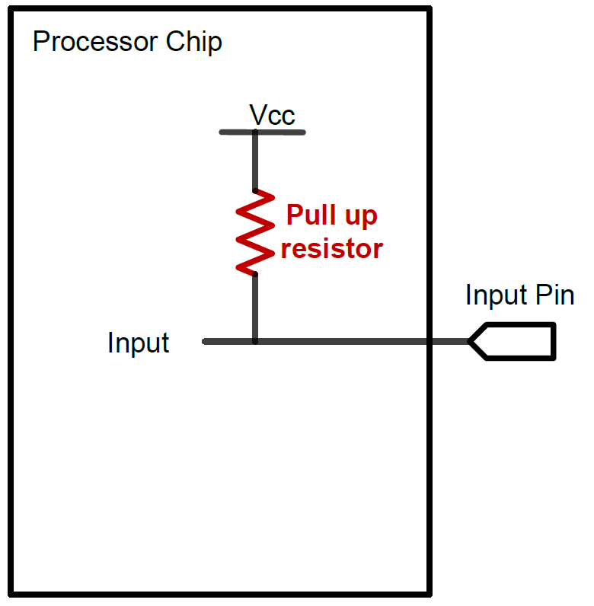
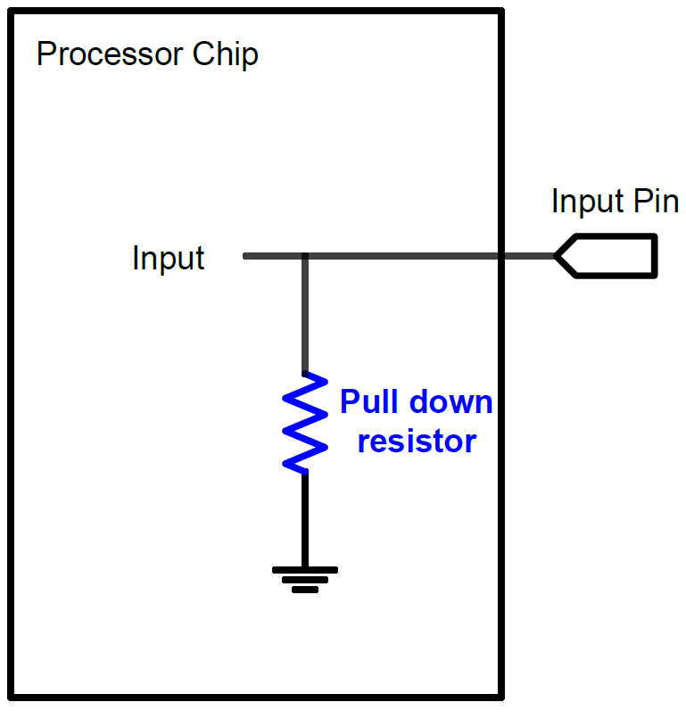
GPIO Input: Pull Up and Pull Down
A digital input can have three states: High, Low, and High-Impedance (also called floating, tri-stated, HiZ)
Pull-Up
Pull-Down
If external input is HiZ, the input is read as a valid HIGH.
If external input is HiZ, the input is read as a valid LOW.

Slide 15
GPIO Output: Push-Pull
GPIO Output = 1
Source current to external circuit

Slide 16
GPIO Output: Push-Pull
GPIO Output = 0
Drain current from external circuit

Slide 17
GPIO Output: Open-Drain
GPIO Output = 0
Drain current from external circuit

Slide 18
GPIO Output: Open-Drain
Output = 1
GPIO Pin has high-impedance to external circuit

Slide 19
Basic Structure of an I/O Port Bit Input and Output
Schmitt
trigger
Notes:
{{Pause=2}} Again, here is the overall diagram of the G P I O module for one I/O pin. In this lecture, we will only focus on G P I O input.

Slide 20
Basic Structure of an I/O Port Bit: Input
Schmitt
trigger
Reduce noise
Increase slew rate
Input Data Register (IDR)
GPIO Pull-up/Pull-down Register (PUPDR)
00 = No pull-up, pull-down 01 = Pull-up
10 = Pull-down 11 = Reserved
Notes:
{{Pause=2}} Except the G P I O mode register, there are two other registers, which are related to G P I O input. They are the input data register (IDR), and the pull-up pull-down register (P U P D R).
{{Pause=1}} The input module, includes one important electronic component, called, Schmitt Trigger. The Schmitt trigger circuit is a special voltage comparator. It has two functions. First, it reduces noises, and provides a cleaner and more reliable signal. Second, it converts a slow signal edge, into a clean edge with instantaneous transition. Thus, it can increase the slew rate of signals.

Slide 21
Schmitt Trigger
Threshold
Analog signals
Noisy
Rise and fall slowly (small slew rate)
Notes:
{{Pause=2}} Let me explain the motivations of the Schmitt trigger. In practice, an analog signal often has electronic noise, introduced by various electronic components. The noise makes the signal fluctuate frequently. In addition, analog signal tends to rise or fall slowly, because of inherent parasitic capacitance, resistance, or induction in electronic circuits. Accordingly, analog signals tend to have small slew rates. The slew rate describes how fast a voltage changes. It is usually measured in volts per microsecond.

Slide 22
Schmitt Trigger
Threshold
Notes:
Let’s see what will happen, if we use a simple comparator, to convert the analog input signal, to a binary digital signal. The simple comparator compares the input voltage with a pre-defined threshold. If the input is larger than the threshold, then the comparator outputs high level. Otherwise, the comparator outputs low level. Here is the output of the simple comparator.

Slide 23
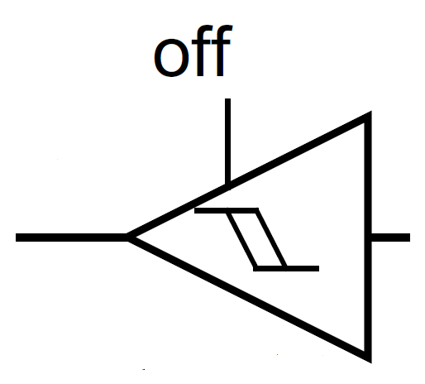
Schmitt Trigger
V_{out}
V_{in}
Notes:
{{Pause=2}} Different from the simple comparator, the Schmitt Trigger is a special circuit, which switches the output, based on two different thresholds. They are called the trigger high threshold, and the trigger low threshold. The output of a Schmitt Trigger depends on the current input, and the history of the input. When the input voltage increases from zero, the output remains low, until the input becomes larger than the high threshold. {{Pause=1}} Similarly, when the voltage decreases gradually, the output remains high, until the input becomes smaller than the low threshold. {{Pause=1}} Any fluctuation in the range between the high and low thresholds is ignored by the Schmitt trigger.
{{Pause=2}} This figure compares the output of the Schmitt Trigger, and the simple comparator. When the input signal fluctuates slightly, the output of the Schmitt Trigger does not switch its output level. For example, at the beginning, the output of Schmitt Trigger is low. When the input signal fluctuates, the output remains low as long as the input signal is lower than the high threshold. Similarly, if the current output is high, even thought the input fluctuates, the output remains high as long as the input is higher than the low threshold.
{{Pause=1}} From this simple example, we can see that, the Schmitt Trigger switches its output, much less frequently than the simple comparator. Accordingly, the Schmitt trigger helps eliminate noise in the input signal.

